Slide 1

How to use the
Solh Organizational Dashboard

Slide 2
First, let’s help you create your credentials

Slide 3
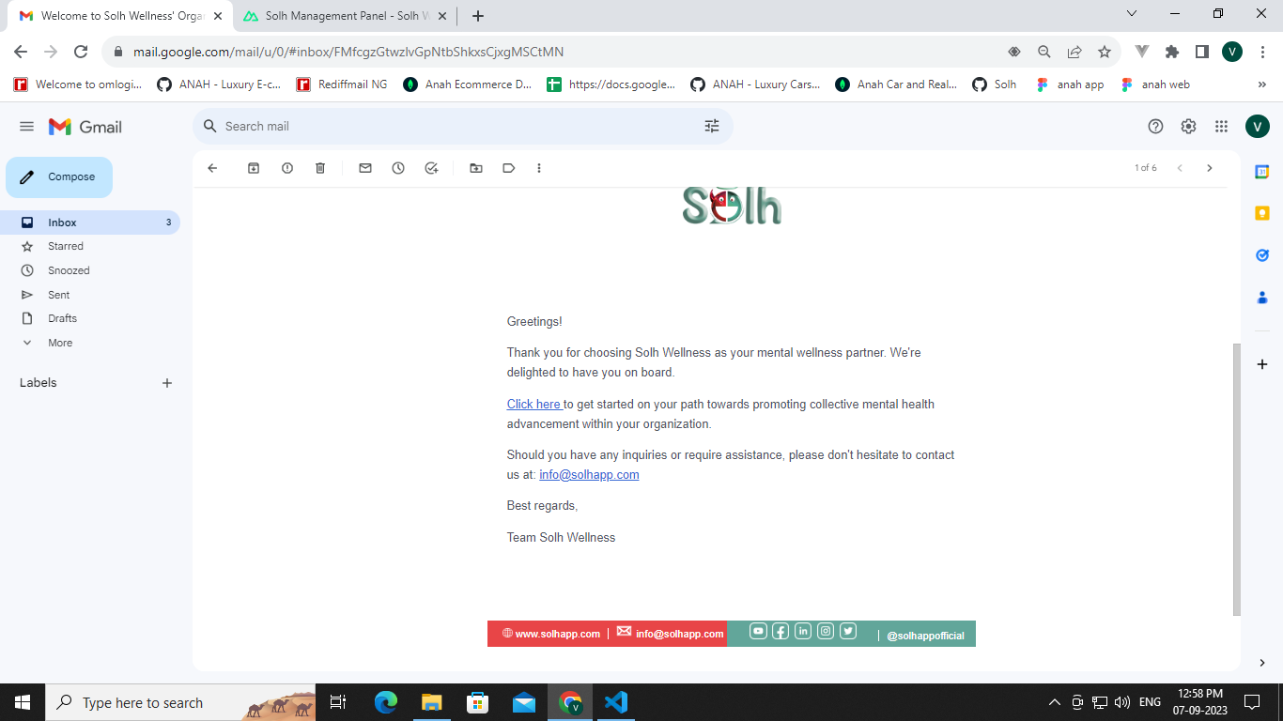
STEP 1
Check your inbox for mail from Solh Wellness. Open the mail and click on ‘Click here’.

Slide 4
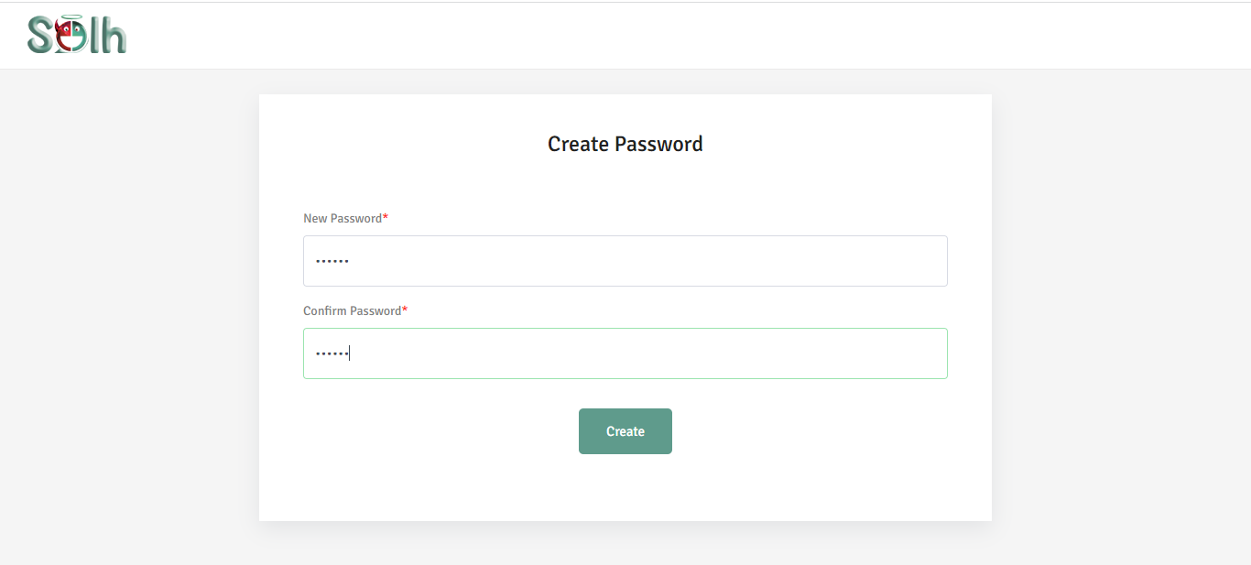
STEP 2
This page will open up. Use it to create your password.

Slide 5
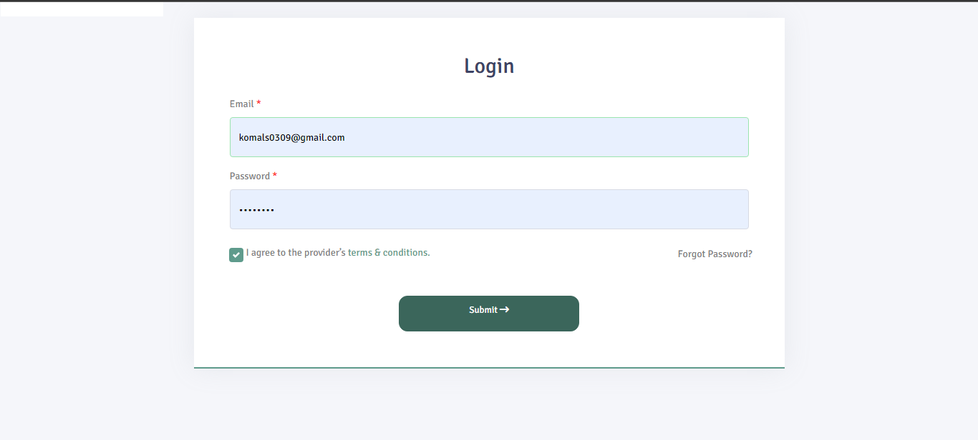
STEP 3
After successfully creating a password, you will be redirected to the SMP* login page.
Note: Use the Email ID on which you received the mail to login along with the password that you created (in the 2nd step)

Slide 6
*What is SMP?
SMP or the Solh Management Panel is our backend system. Logging into it with your registered Email ID will give you access to the Organizational Dashboard from where you can customize your organization’s in-app experience and see data reports of your employees.
STEP 4
After successful login, you will be redirected to the Organizational Dashboard.

Slide 7
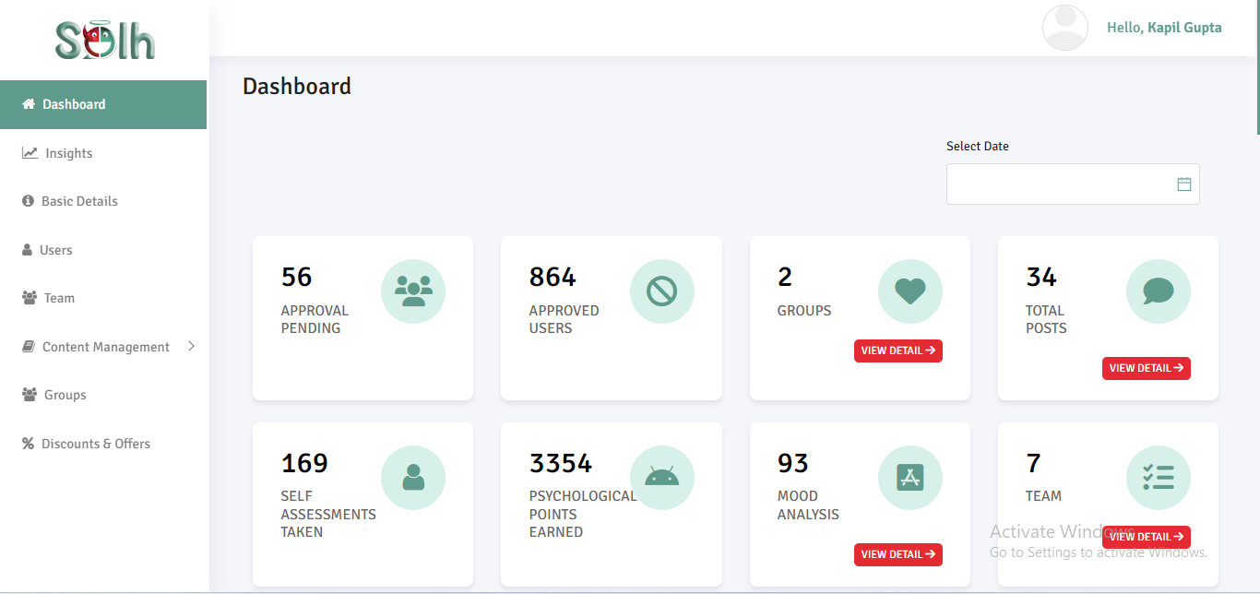
Once you are logged in, this is what your screen will look like!

Slide 8
Now that you’re logged in, let’s create your profile

Slide 9
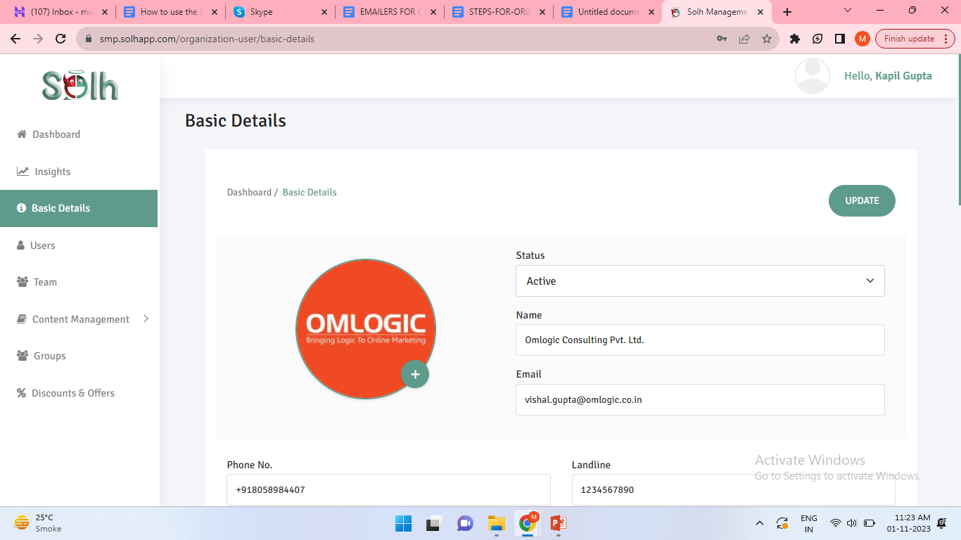
To set up your profile, go to ‘Basic Details’ and edit and fill details of your organization.

Slide 10
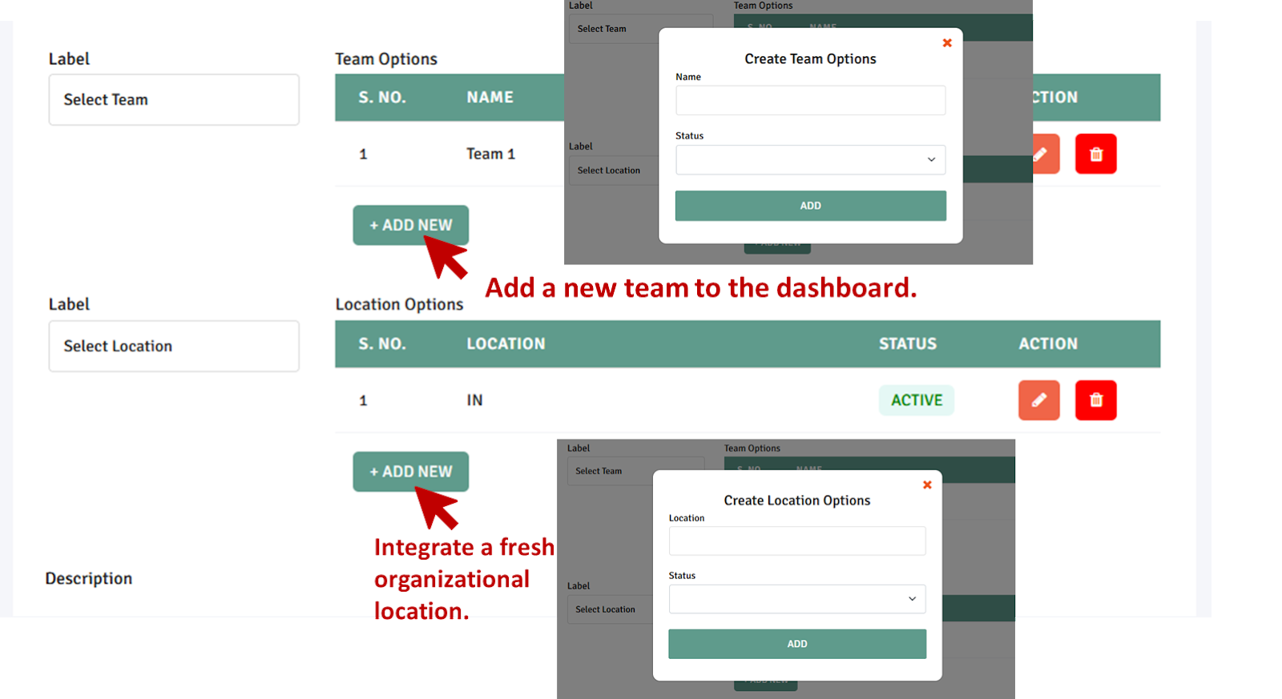
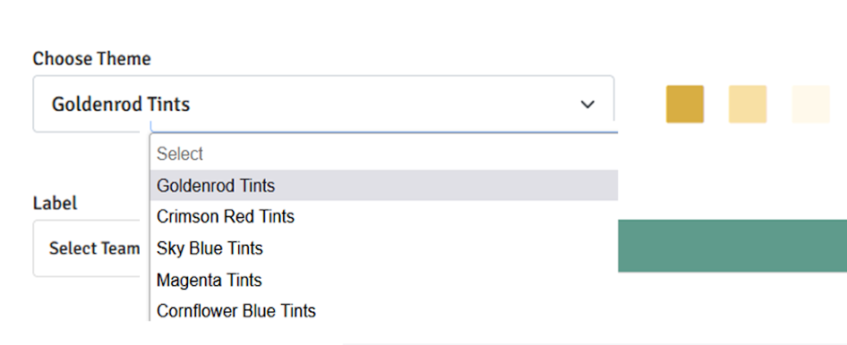
Here you can:
Add Teams and Locations
Select Colour Themes

Slide 11
Some things to keep in mind!
Status of organization should be set to ‘Active’.
- The ‘Official number’ should be registered on Solh App and should always remain in an active state. All posts are made exclusively from this particular number.
Once done, click on ‘Update’ at the top to save your changes!

Slide 12
How to Let People Into the Organization

Slide 13
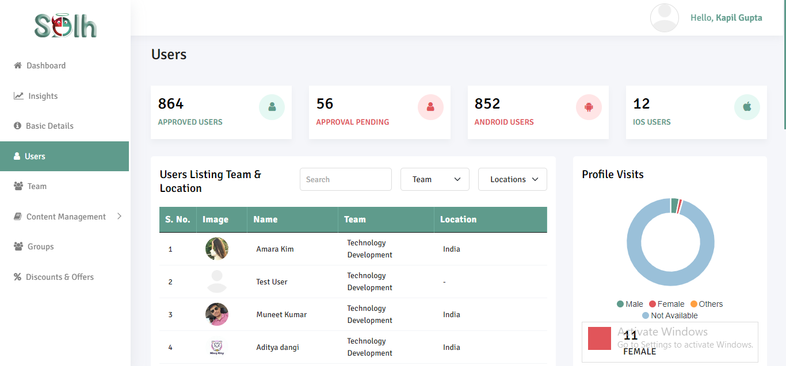
STEP 1
Go to the ‘Users’ tab in the sidebar menu. This screen will open.

Slide 14
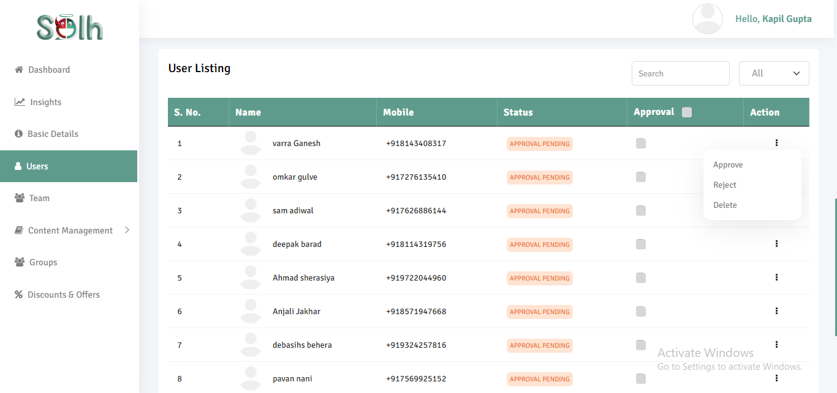
STEP 2
Scroll below, you will find the list of people who have requested to join.
Approve: Accept request
Reject: Deny request
Delete: Remove request

Slide 15
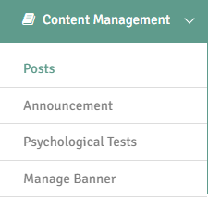
Now, let’s look at Content Management
Under this you can manage:
- Posts
- Announcements
- Psychological Tests
- Banners

Slide 16
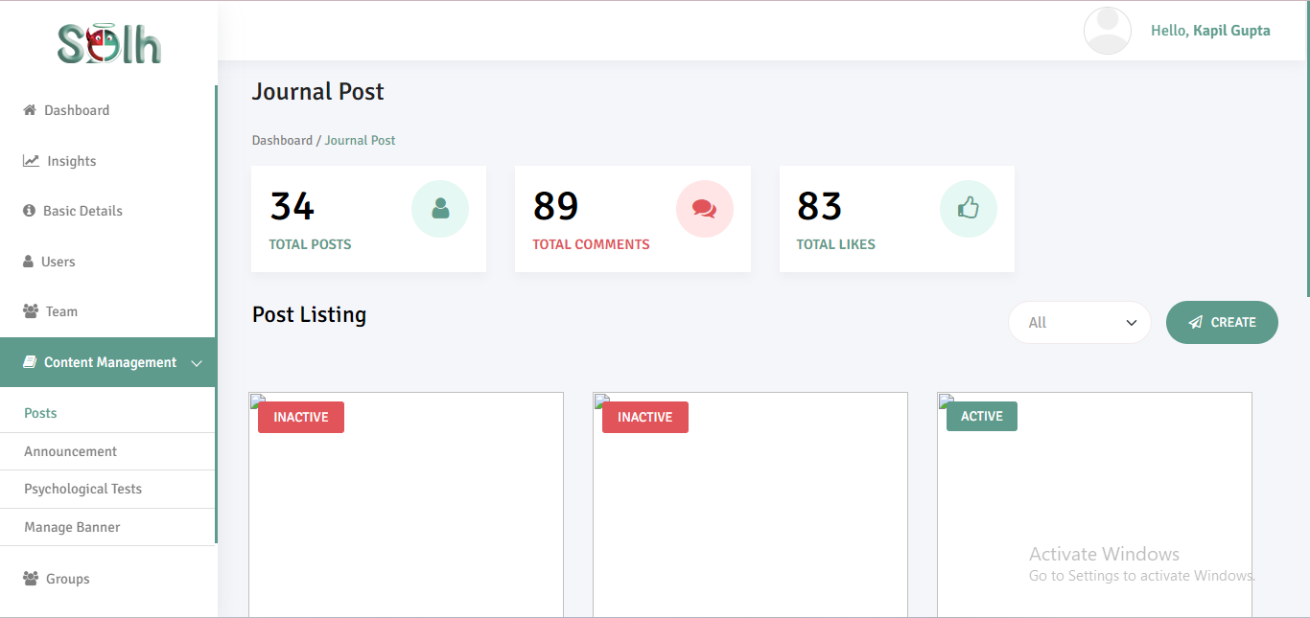
1. Managing posts
Here you can view all journal posts that have been made in the organization and also create new posts.

Slide 17
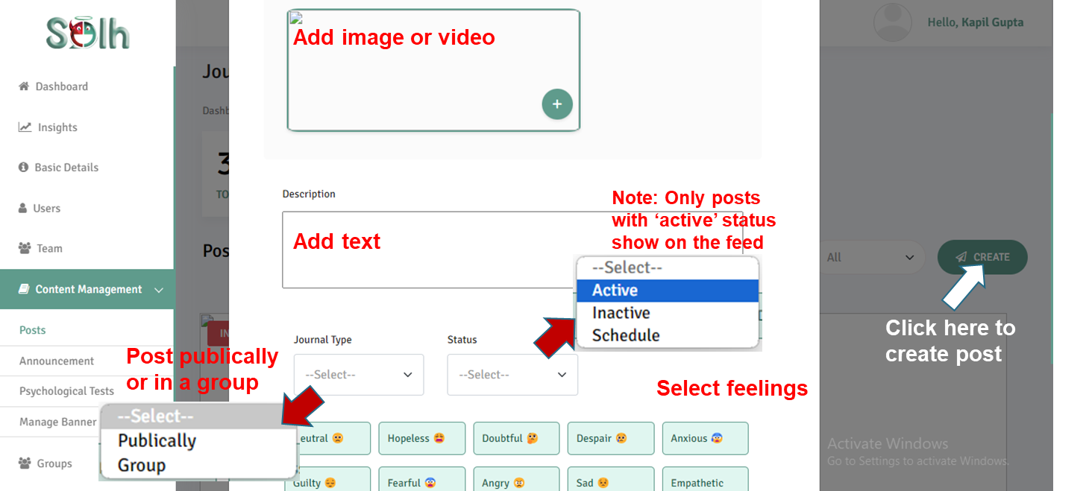
1. Managing posts
Here you can view all journal posts that have been made in the organization and also create new posts.
Once done, click on ‘Publish’ at the bottom to post (if scheduled, it will get posted at the selected time).

Slide 18
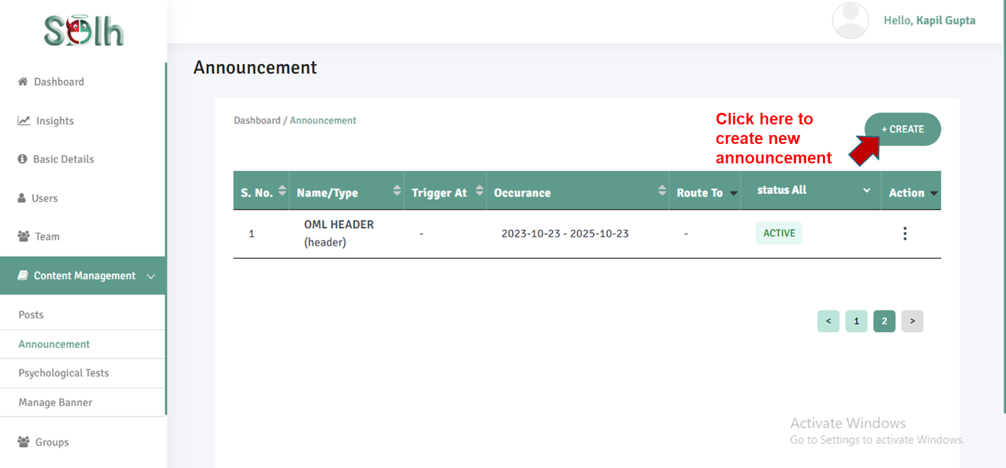
2. Managing announcements
Here you can view and create announcements to send out to members of your organization.

Slide 19
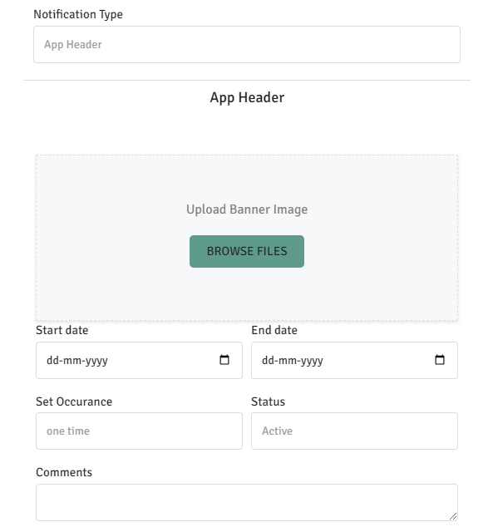
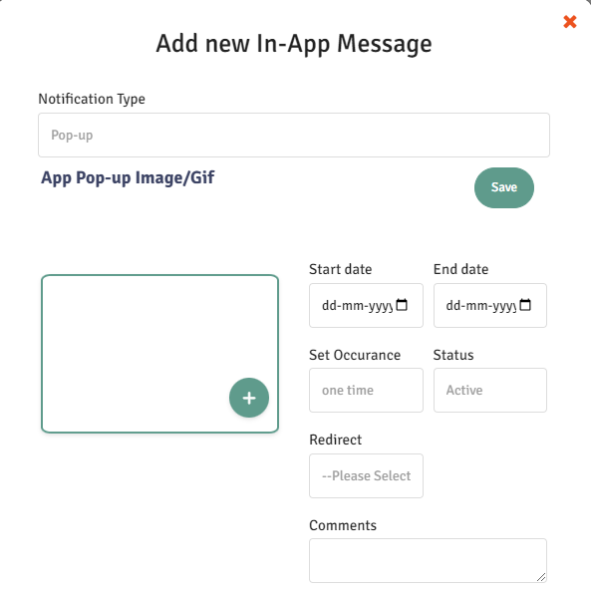
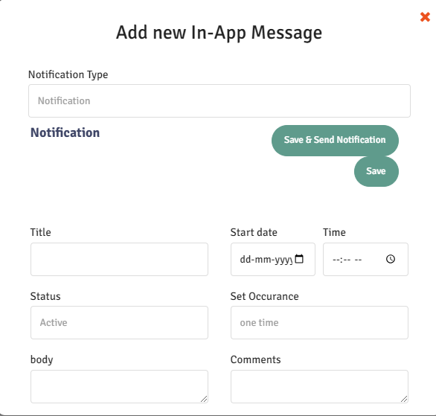
2. Managing announcements
Announcements can be sent out in three ways:
As Header
As Pop-up
As Notification
Don’t forget to save by clicking on ‘Publish’ at the bottom once done!

Slide 20
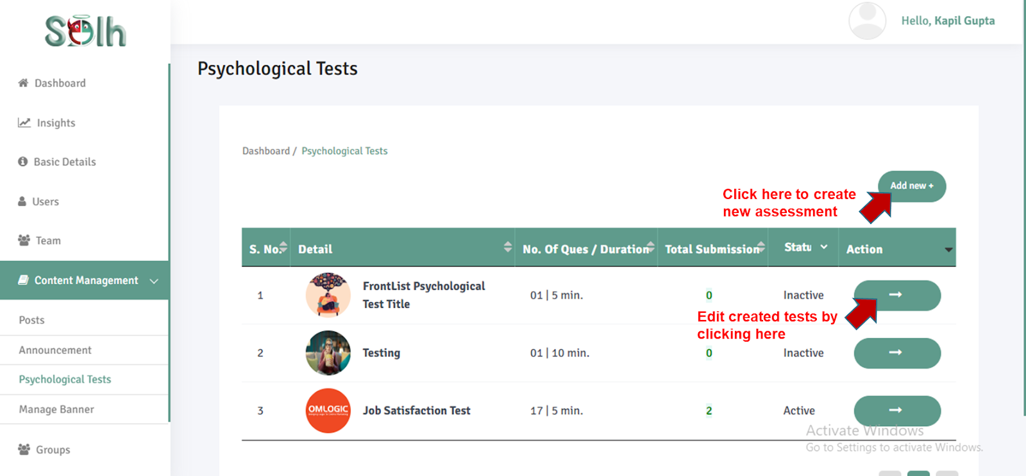
3. Managing psychological tests
Here you can add new self assessment tests exclusively for members of your organization.

Slide 21
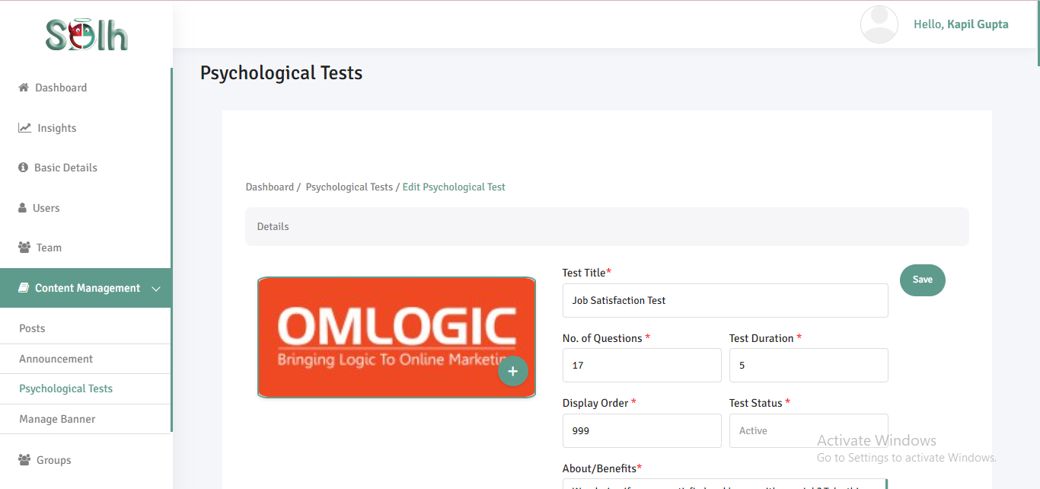
3. Managing psychological tests
Don’t forget to click ‘Save’ on your changes once done.

Slide 22
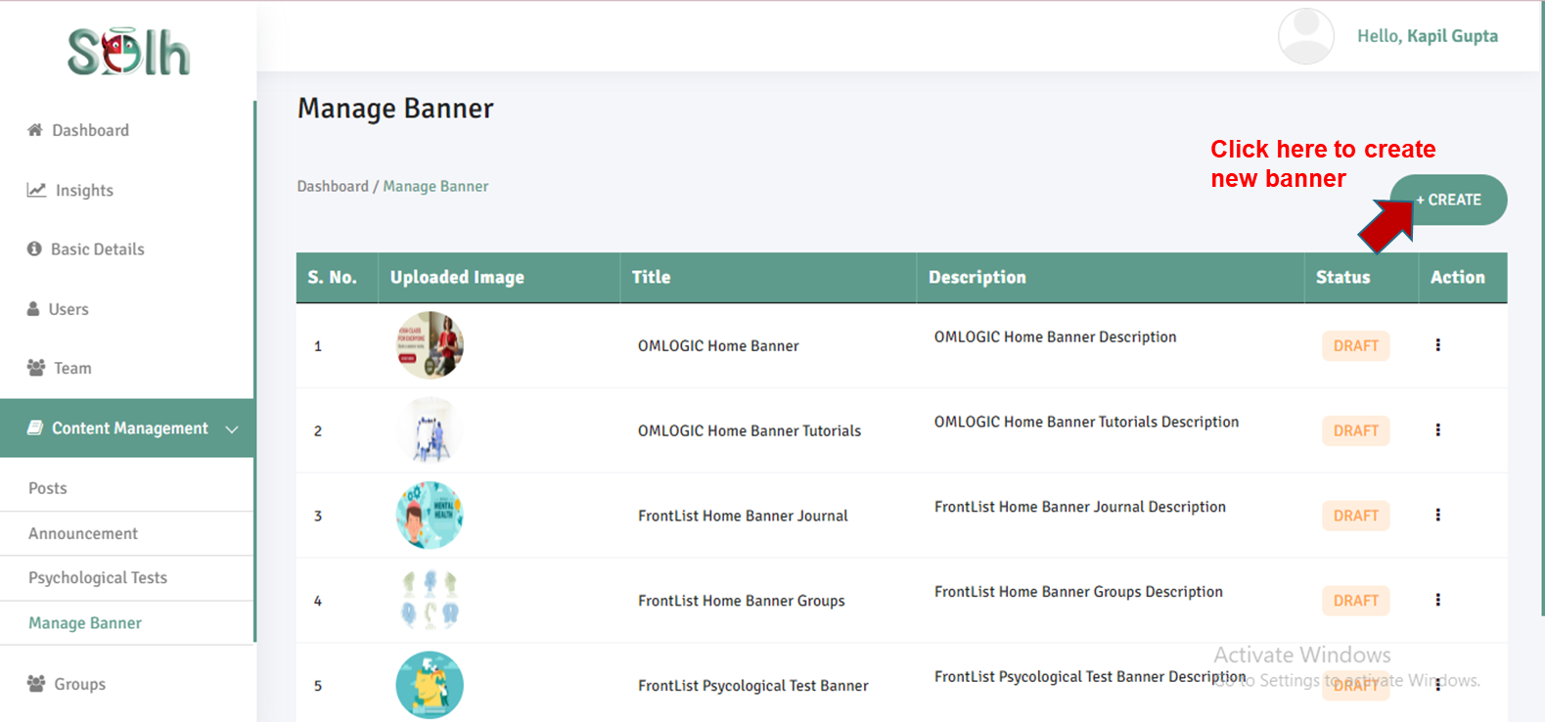
4. Managing banners
Here you can add banners which appear in the middle of the app.

Slide 23
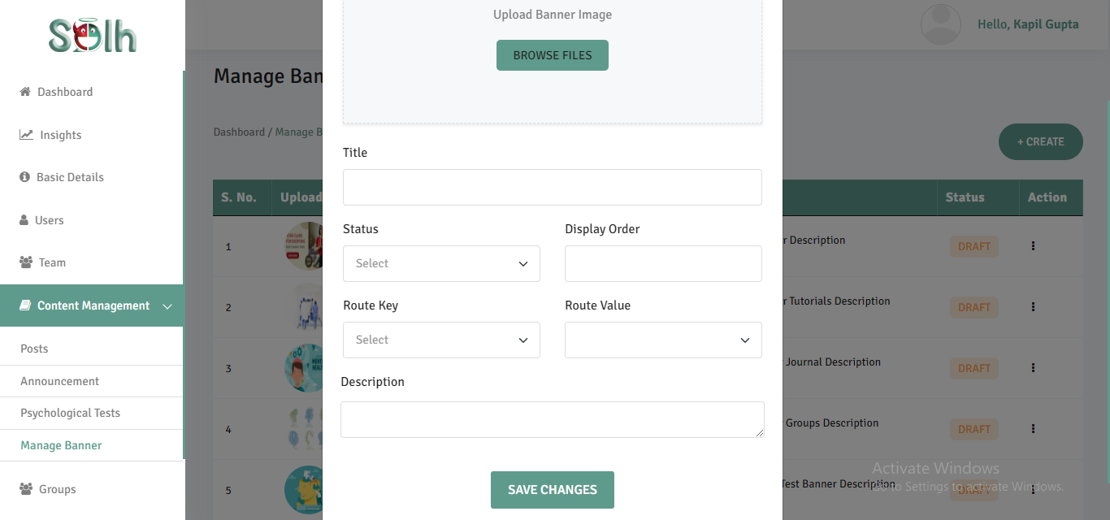
4. Managing banners
Once done, click on ‘Save Changes’.

Slide 24
Other Things You Can Do
With the Dashboard

Slide 25
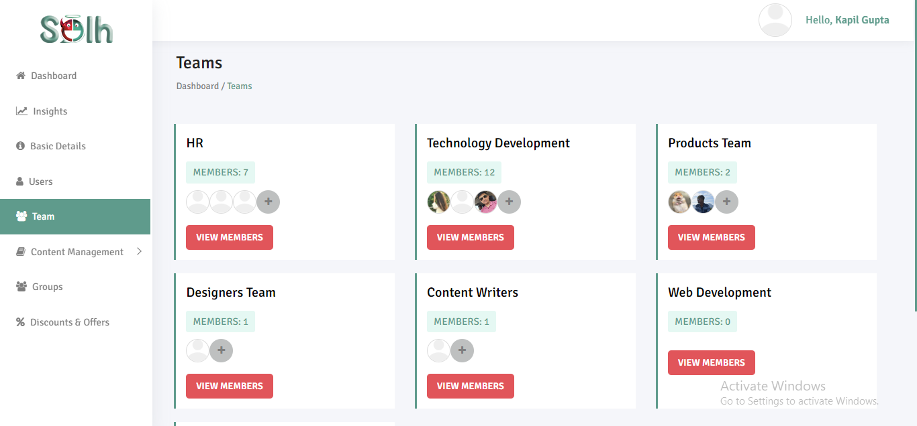
1. teams
Open the ‘Teams’ tab to view and manage teams.

Slide 26
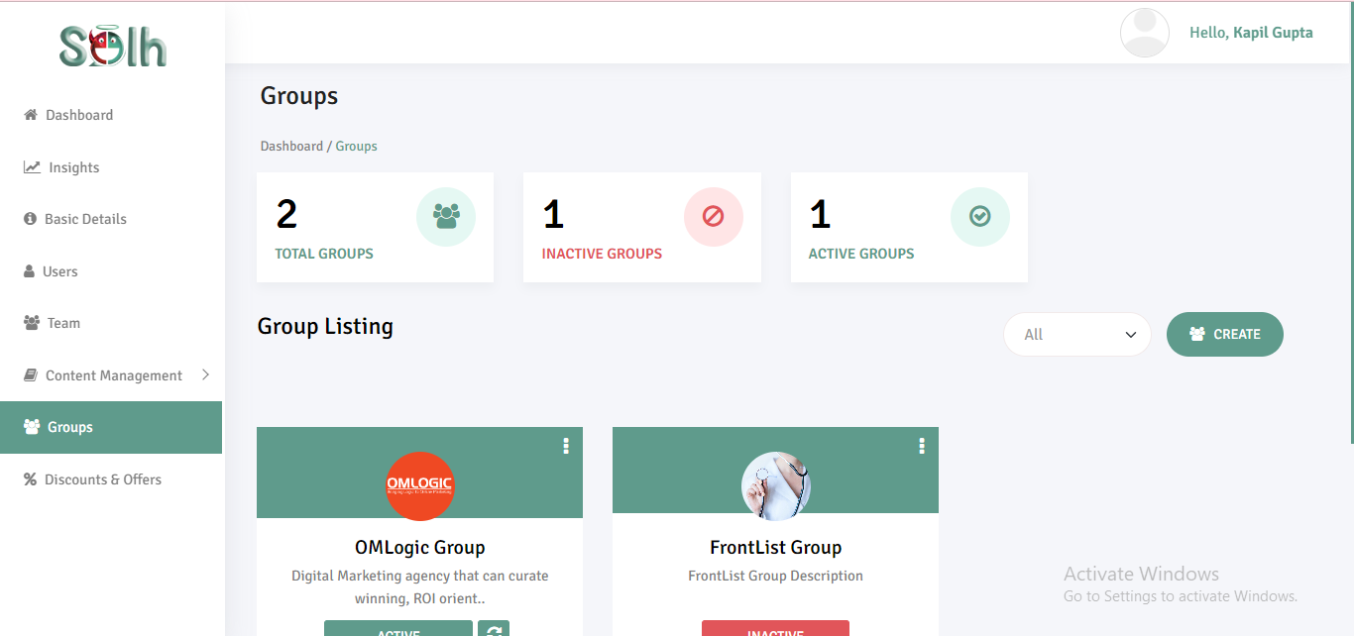
2. groups
Open the ‘Groups’ tab to view and manage support groups.

Slide 27
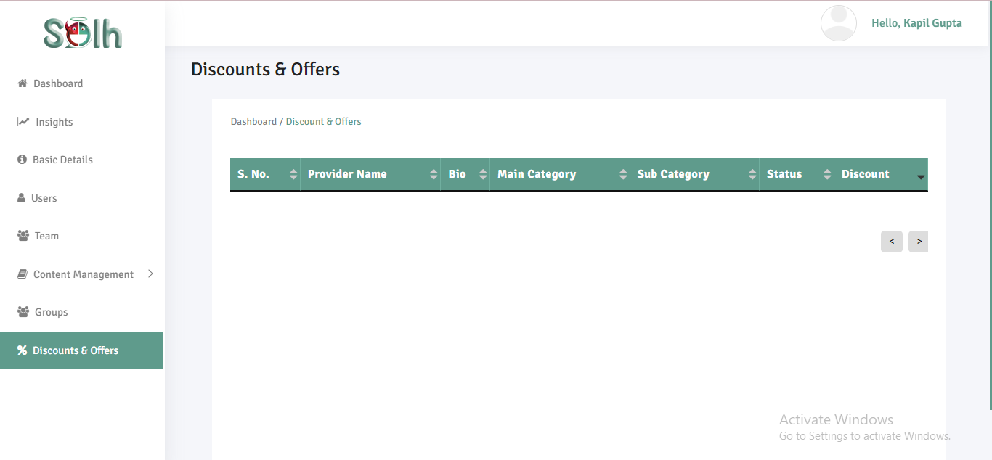
3. Discounts and offers
Open the ‘Discounts & Offers’ tab to view currently available discounts on therapies.

Slide 28
Next, let’s discover the Metrics that the Solh Organizational Dashboard gives you!

Slide 29
Measurability becomes a very crucial factor when you are implementing any tool for your organization.
The measurability built into the Solh system helps you:
See how the platform is being used by your employees
Track wellness of members of your organization
Use the data to define actionable strategies and interventions (if required) to improve the existing wellness level of your organization
Discover what metrics come with the Solh Organizational Dashboard!

Slide 30
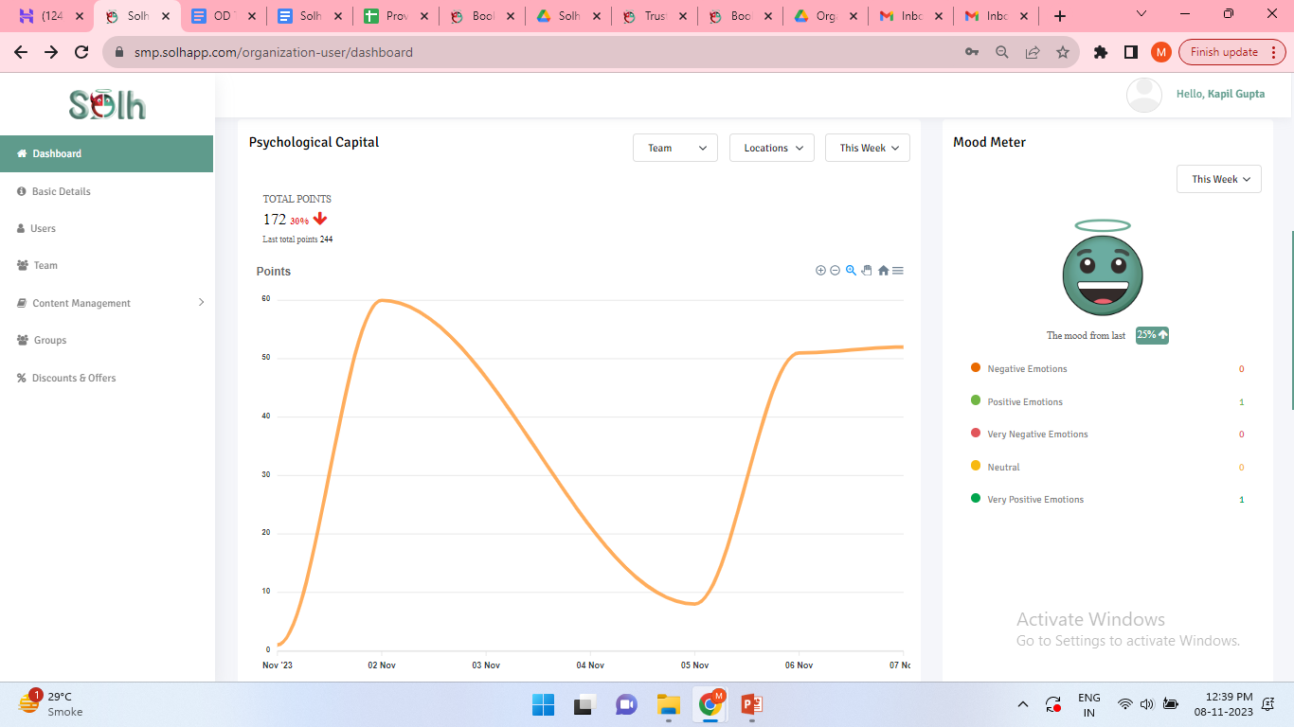
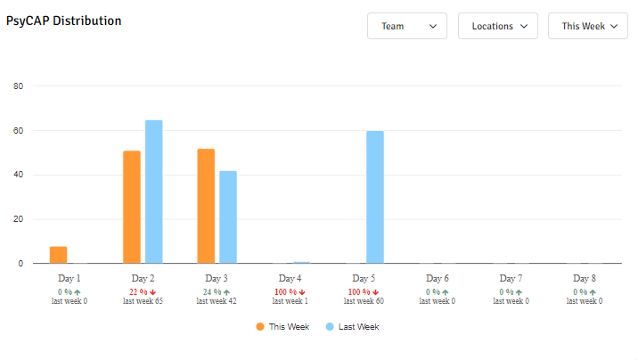
1. Psychological capital
Every activity you do on the Solh app, like liking a post, reading a blog, putting a comment or sharing something, helps you gain points that we refer to as Psychological Capital or PsyCap.
This metric has been created to help you understand how different teams and groups within your organization are utilising the platform and the steps they are taking on working towards their mental wellness.

Slide 31
2. Mood meter
At Solh, Green is Goodness! The Mood Meter helps you identify how happy or sad you are by analyzing your daily moods and, over a period of time, helps identifies patterns within the same.
From an organizational standpoint, it can help you see how the moods of your employees change from day to day, giving you a measure of the general affect of the people in your organization.

Slide 32
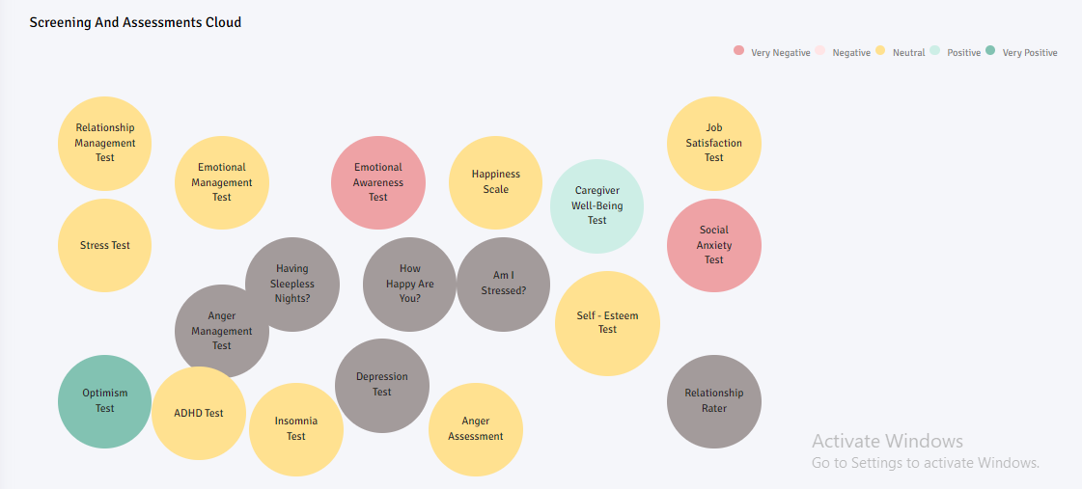
3. WELLNESS CLOUD
Our Wellness Cloud shows you the different self assessments people in your organization have taken and presents the data in a cloud format.
The greener the cloud, the better the overall wellness level. Larger spheres denote a larger number of people attempting that assessment. Any organization where most of the clouds are on the green side reflects – something must be going well!

Slide 33
THANK YOU

